Slide 1


USER REGISTRY
DBMS PROJECT

Slide 2
INTRODUCTION
A login and registration system helps users create accounts and log in securely. This project is designed for a website using a local server. It includes a login page, a registration page, and server-side scripts to handle user authentication. The system ensures that only registered users can access certain parts of the website.

Slide 3
HOW IT WORKS
Users can sign up by entering their username, email, and password on the registration page. Their details are stored in a database. The login page allows users to enter their username and password to gain access. If the details match the database records, they can log in successfully. The project also includes CSS styling to make the interface look neat and user-friendly.

Slide 4
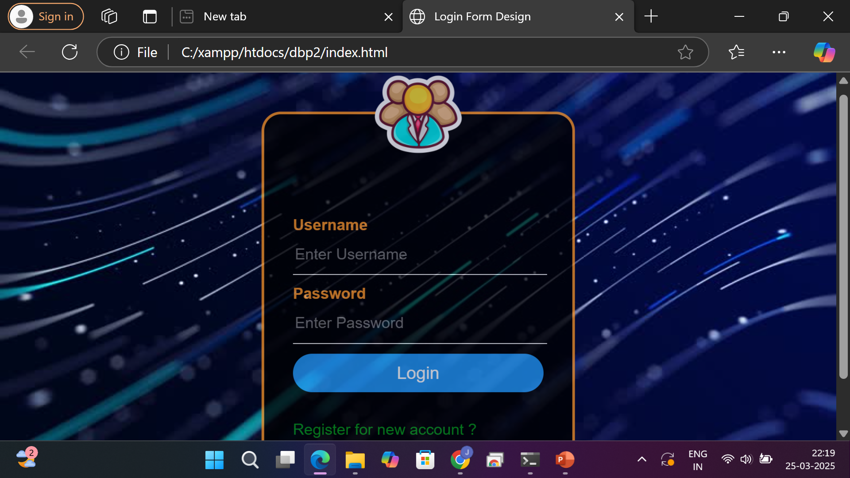

Slide 5
SECURITY AND IMPROVEMENTS
To keep user data safe, features like password encryption and input validation should be added. Preventing SQL injection and using secure login methods can make the system more secure. Additional features like password recovery and email verification can improve the user experience.

Slide 6
CONCLUSION
This project provides a simple and effective way to manage user login and registration. While it works well, adding more security features and design improvements will make it even better. A well-built authentication system is important for any website that requires user accounts.

Slide 7

THANK YOU
URK23DS3010
JAI PRAKASH
URK23DS3041
HEZRON SAMUL

